Slide 1
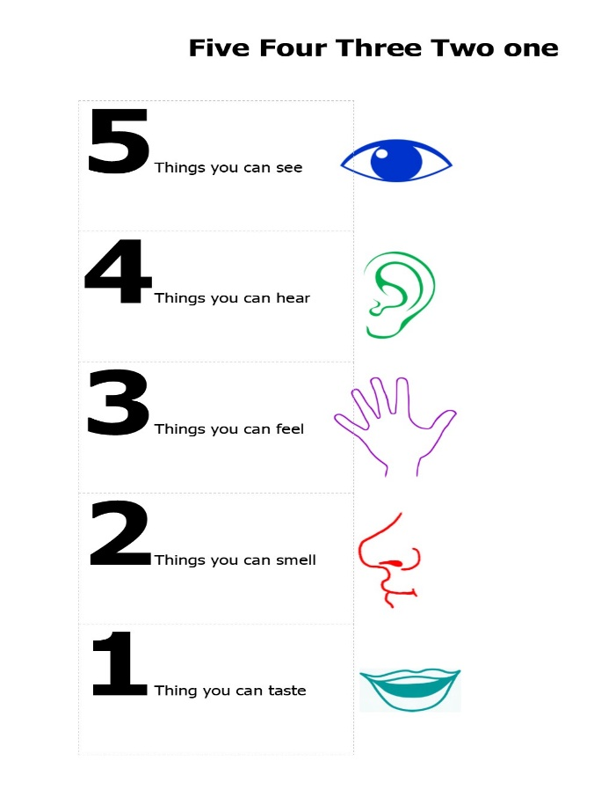
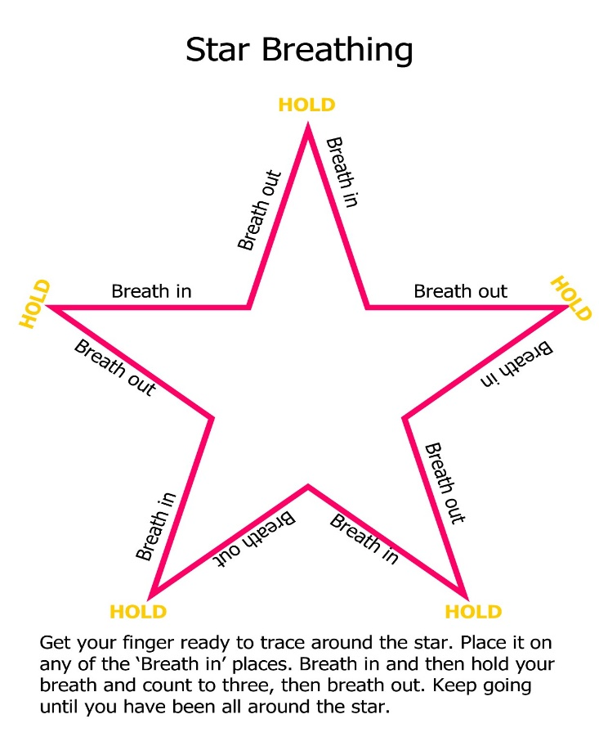
Ways to calm your system
My Learning
Passport
Breathe out
Breathe in
Breathe in
Breathe out
Breathe out
Breathe in
Picture of young person here
Breathe out
Breathe in
Breathe out
Breathe in
Get your finger ready to trace around the star. Place it on any of the breathe in places. Breathe in and then hold your breath and count to three, then breathe out. Keep going until you have been around the star.
We are all different and so we have to find the best way for each person to calm their system. Doodling can help as well as a walk to the loo to get a drink of water. What is the best way for you?
Name:
Class:

Slide 2
Important things to know about me.
This is me doing something I love.

Slide 3
People who are important to me.
Things I like doing outside of school.

Slide 4
Things I have achieved at school.
Things I like doing out of school.

Slide 5


Things in school I find easy and enjoy.
Things in school I find difficult.

Slide 6


Things that help me work well.
Things that make it difficult to work well.
Write/draw 6 things that help you work well at school.
Which adults can help you and how?

Slide 7


What my friends say about me.
What my teachers say about me.

Slide 8
My Targets
Review of my Targets

Slide 9

My Learning Plan
Write down some strategies or resources which can help you achieve your targets.
__________________________________________
__________________________________________
__________________________________________
__________________________________________
__________________________________________
__________________________________________
__________________________________________
__________________________________________
Are there any other things that you would like the staff at school to know about you, the challenges you face, the ways they can help or things that make you happy.

Slide 10
Date | Pupil comment
Date | Parents comment

