Slide 1
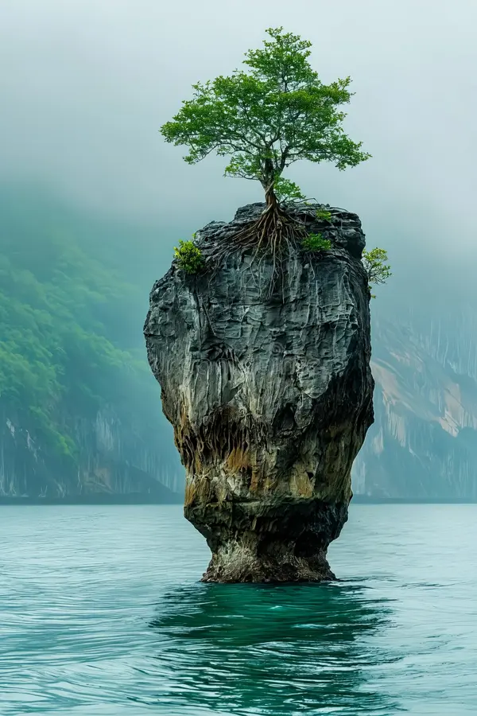
Building
Resilience
Successfully adapting to difficult or challenging life experiences, especially through mental, emotional, and behavioural flexibility and adjustment to external and internal demands.

Slide 2
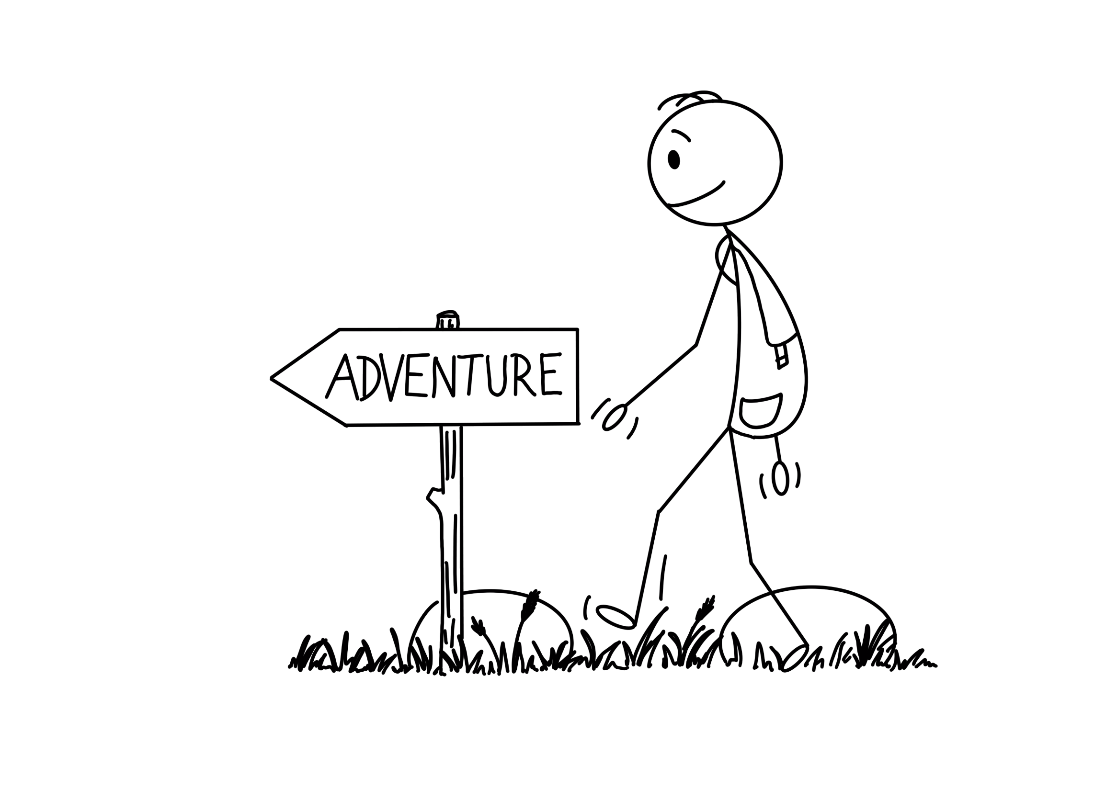
Every day is an adventure.

Slide 3
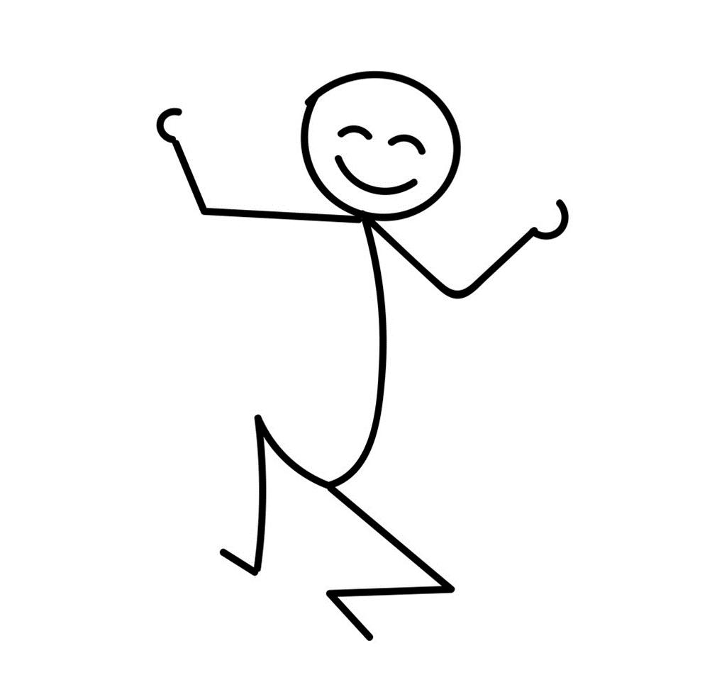
Some days are easy and fun.

Slide 4
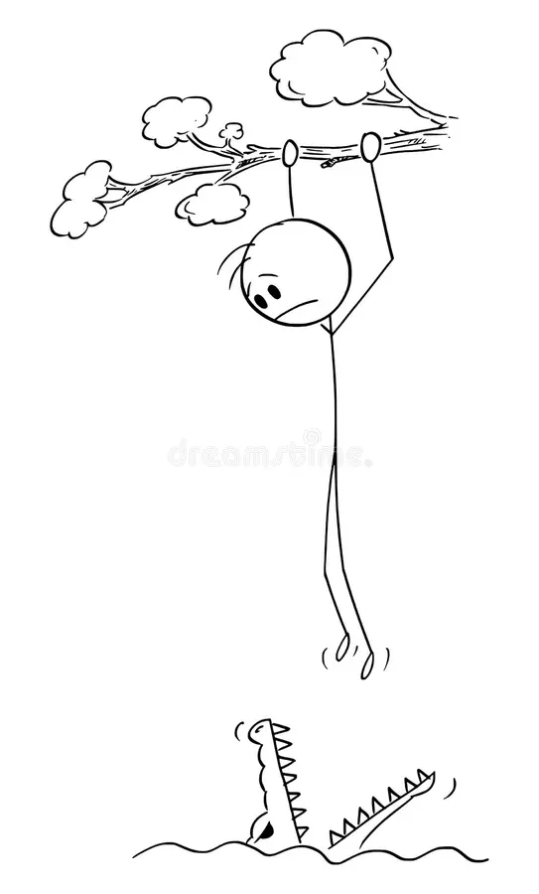
Others are full of challenges, tricky situations and cause us to become stressed.

Slide 5
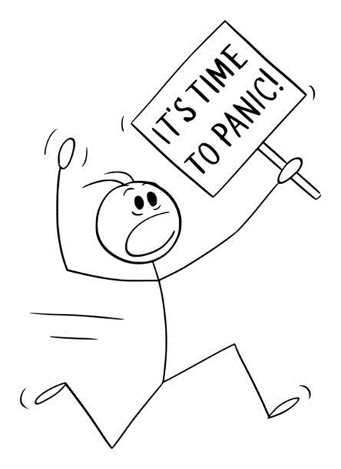
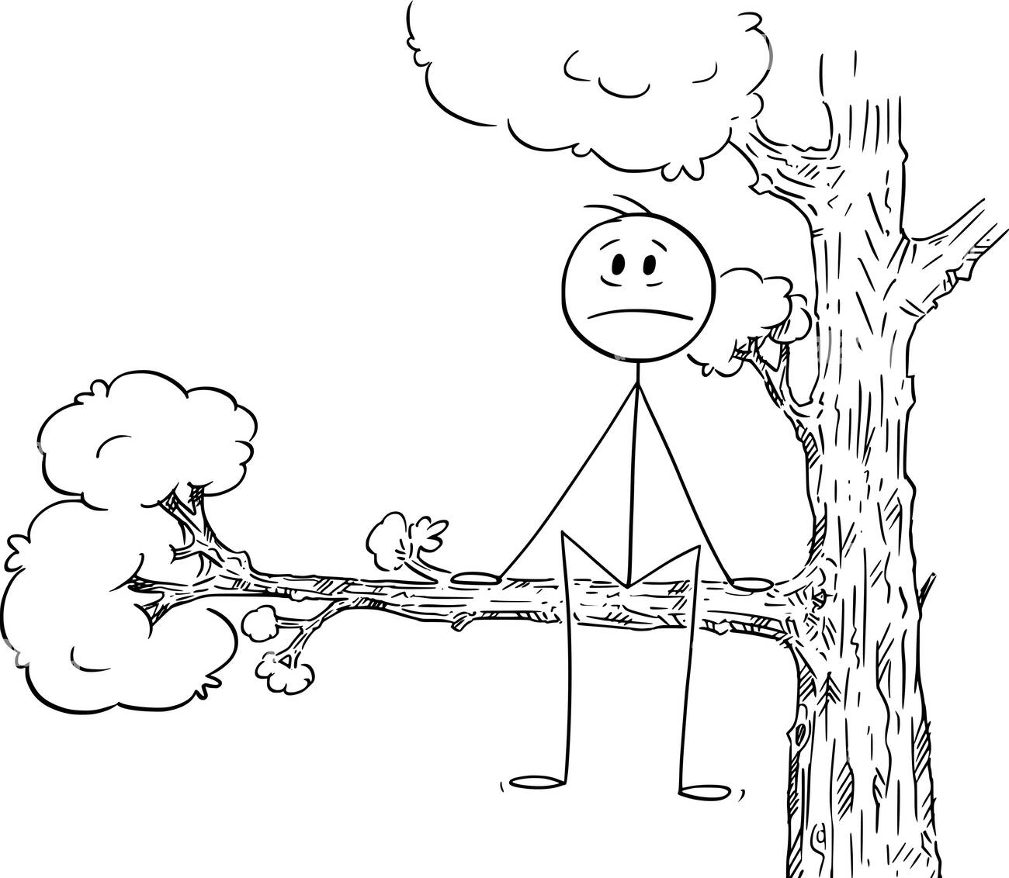
How we adapt to a situation that we didn’t expect or like or find a challenge is important.

Slide 6
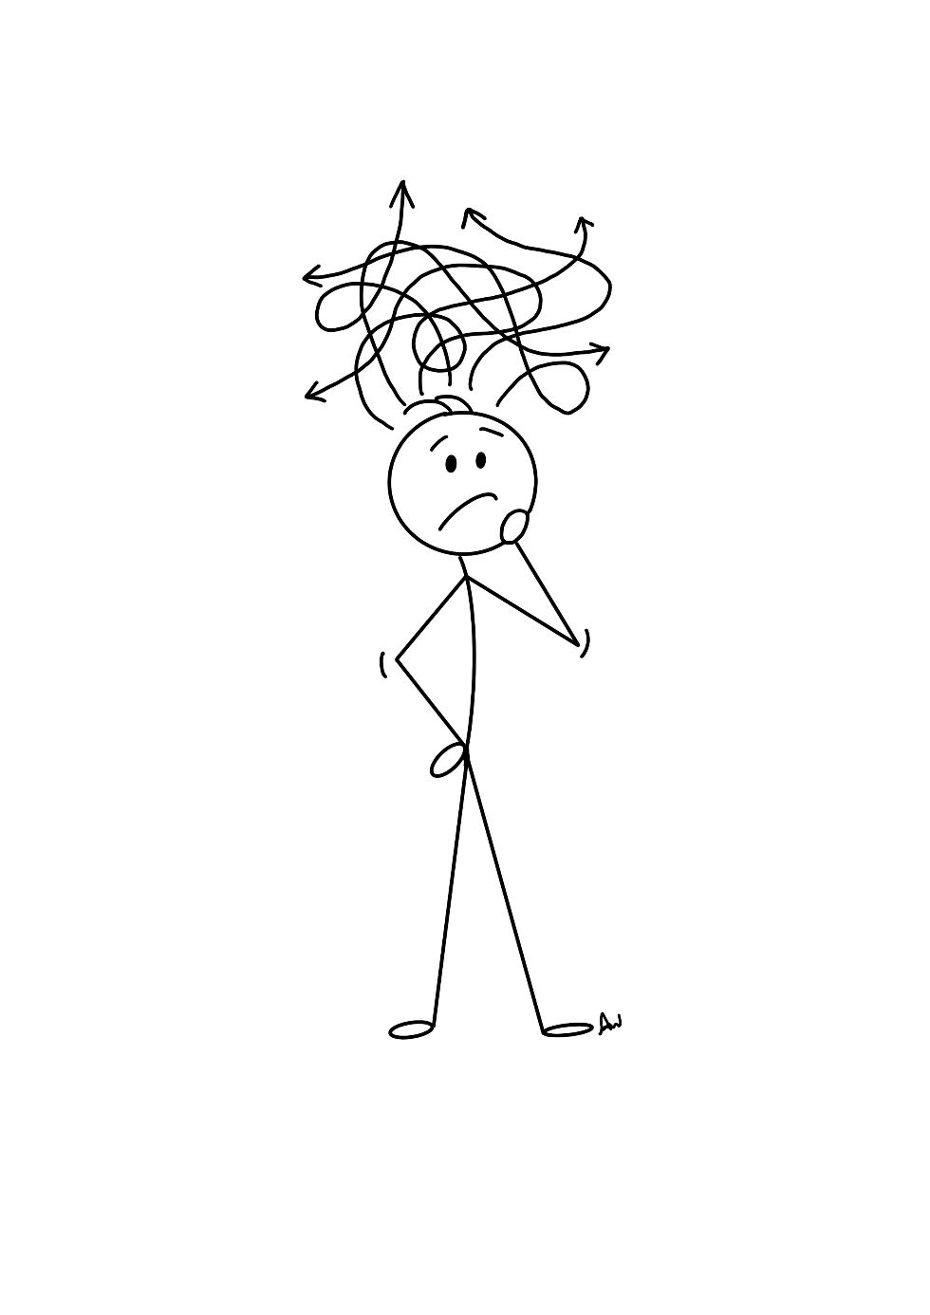
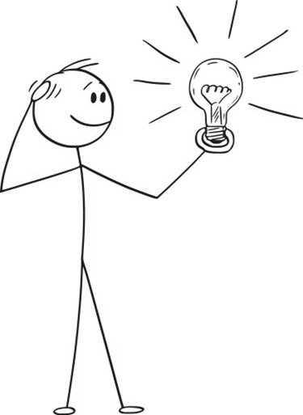
Learning ways to help us manage challenges can really make a difference.

Slide 7
Building stress resilience
Short video

Slide 8
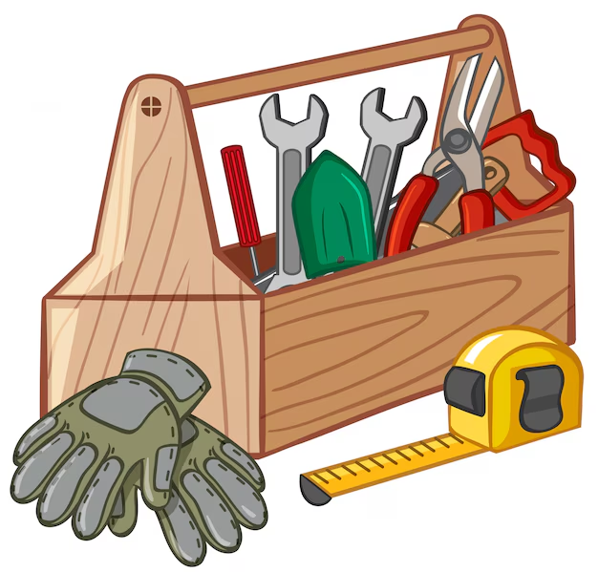
Resilient people have the following skills in their toolkit. They have spent time and energy developing them.

Slide 9

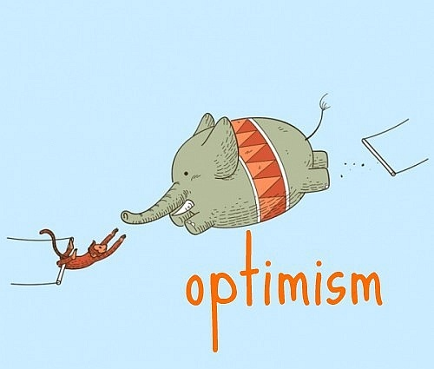
Self belief
Notes:
Optimism
Self belief
Adaptability
Emotional regulation

Slide 10
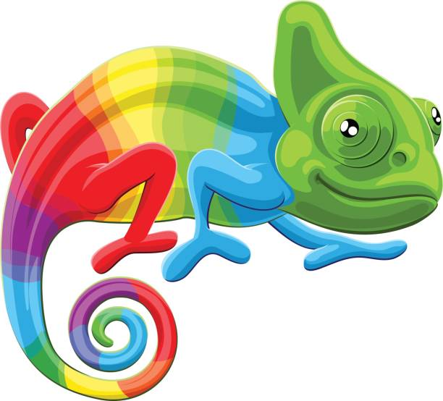

Adaptable
Regulate emotions

Slide 11

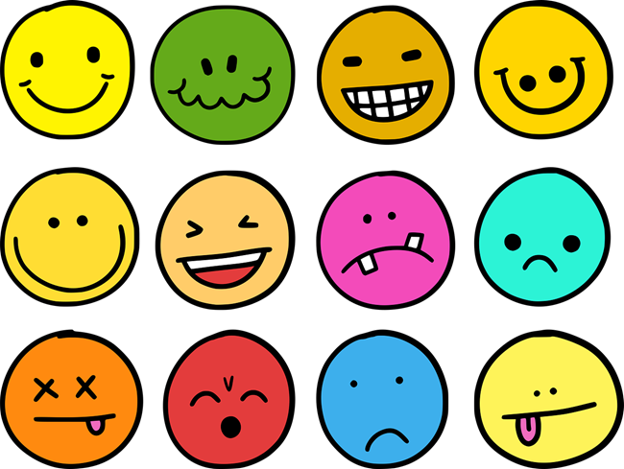
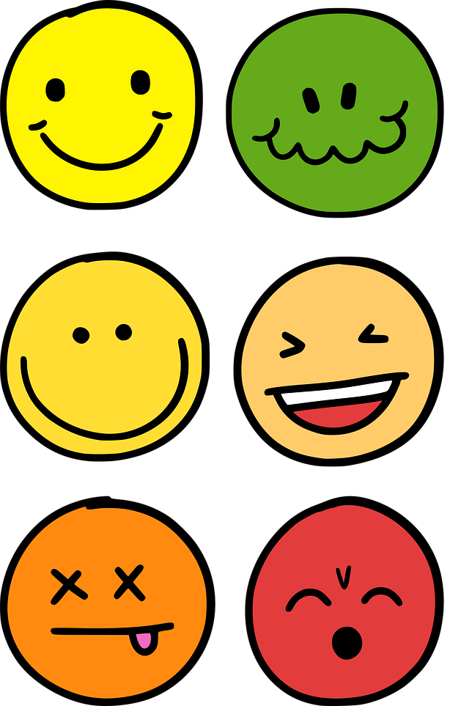
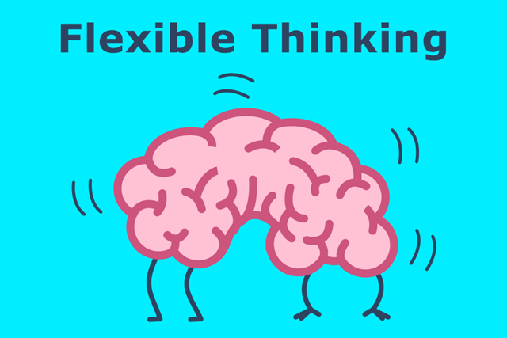
Emotional awareness

Slide 12
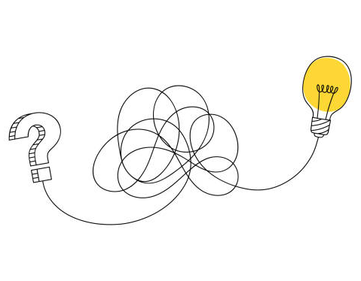

Problem solve

Slide 13
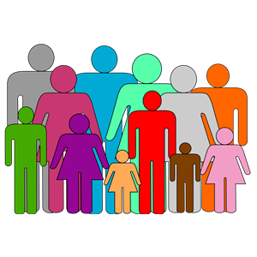
BUT….
Family and Friends

Slide 14
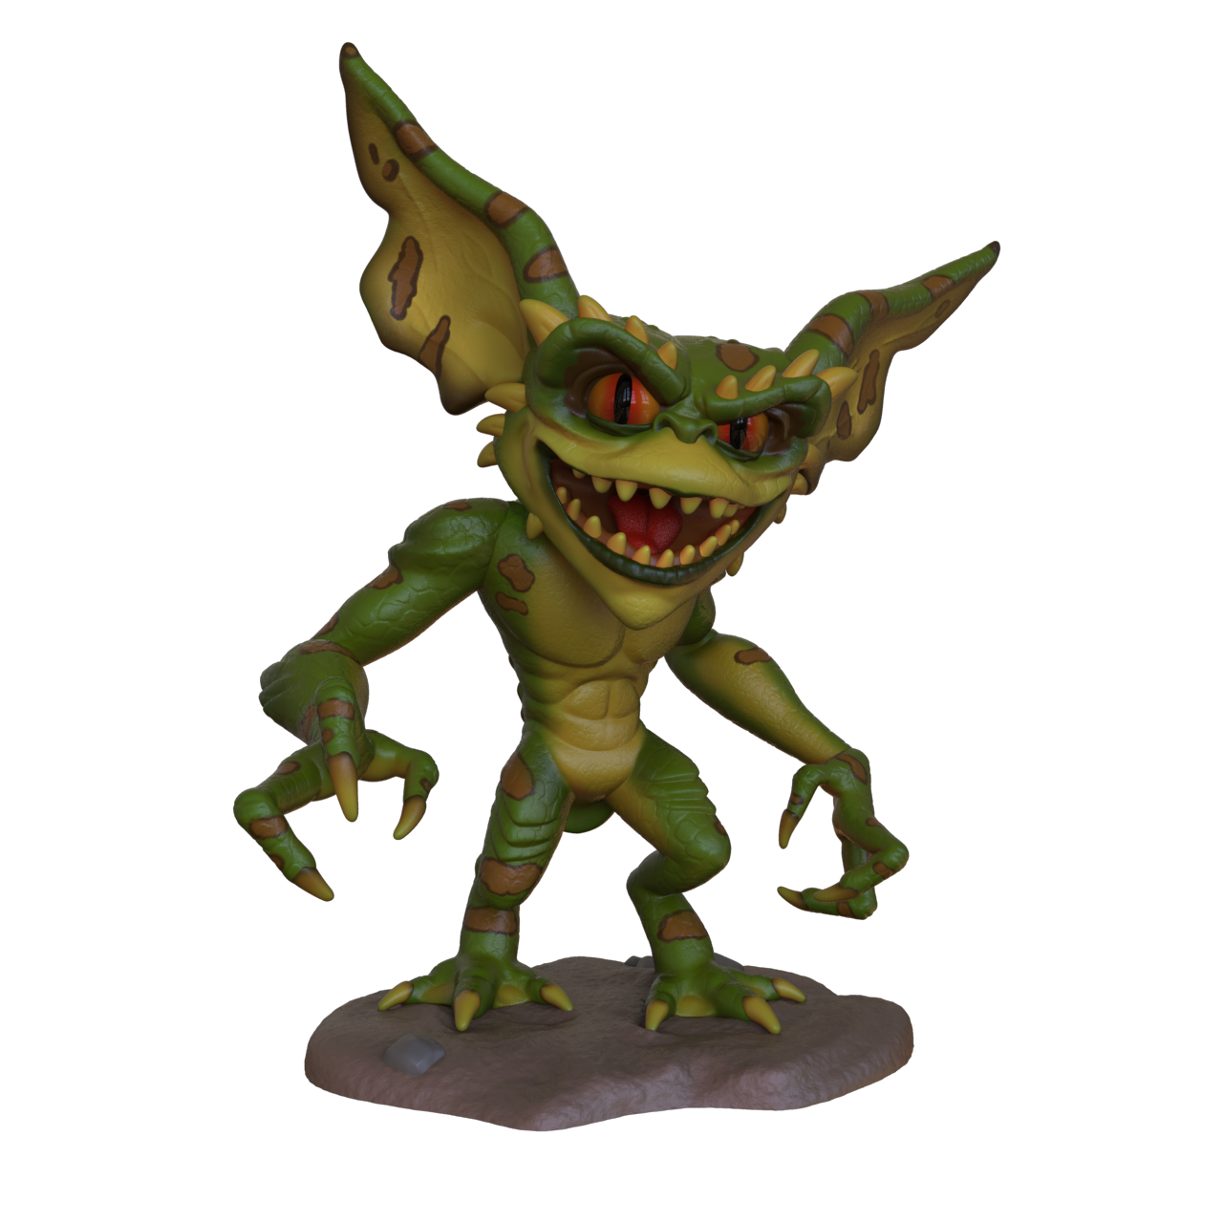
Watch out for the
Gremlins!
Notes:
The Gremlins are the negative thoughts that eat away at your resilience They are the ….
I’m not good enough
I’ll never learn this
I’ll never be able to
I’m not lucky enough
I can’t do that
And the What iff’s – what if I fail? What if people laugh? What if I can’t do it?

