Slide 1
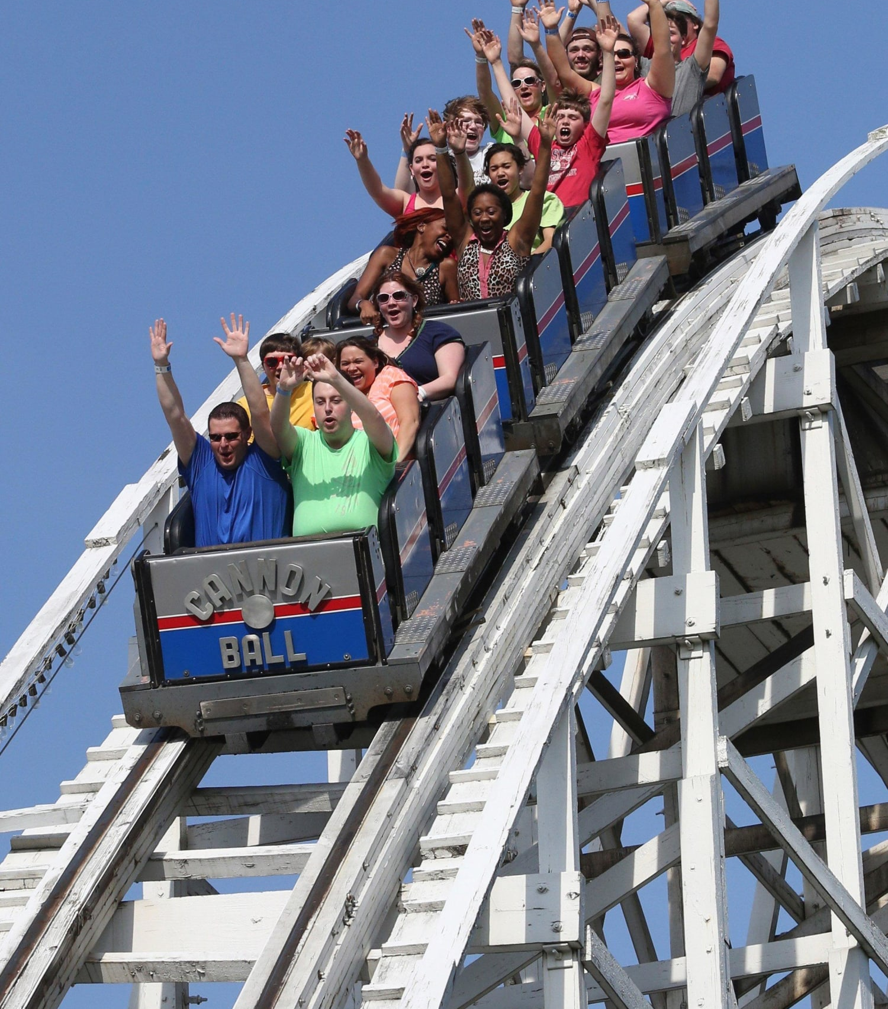
Welcome to the Rollercoaster!
You made it. You are officially Year 7

Slide 2
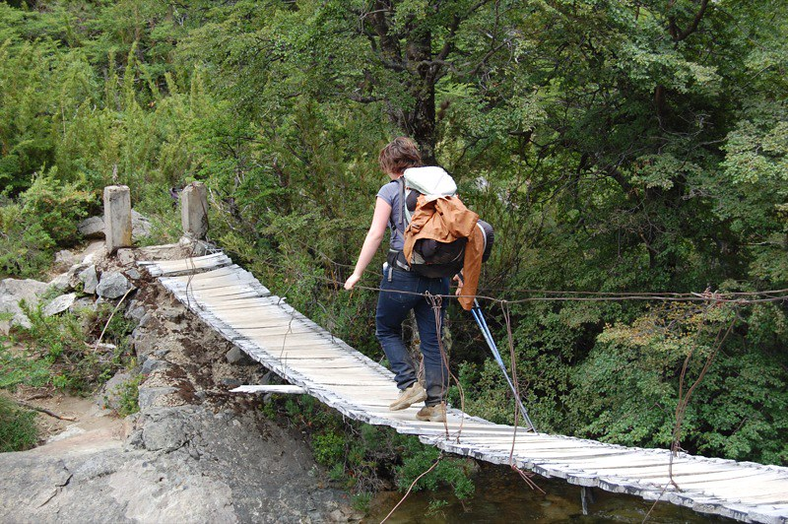
Here we go!!
You have landed on the other side.

Slide 3
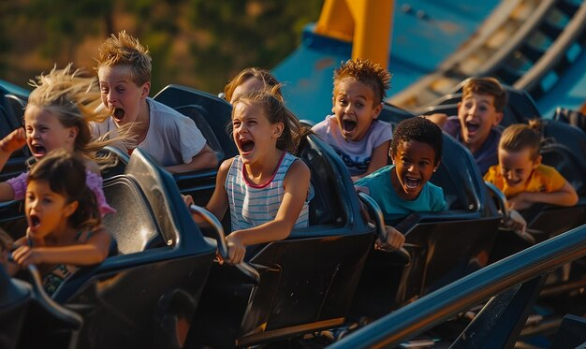
The Roller Coaster of Change

Slide 4

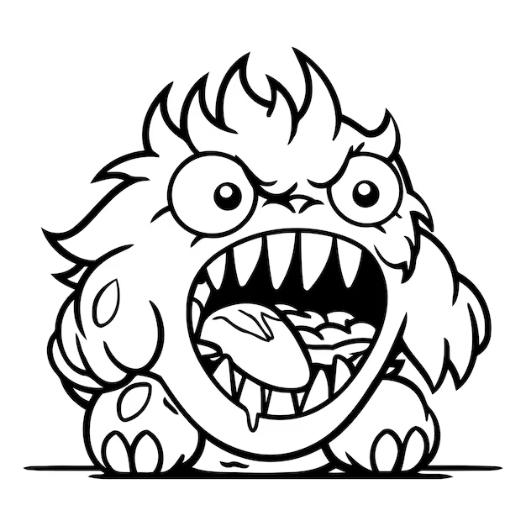
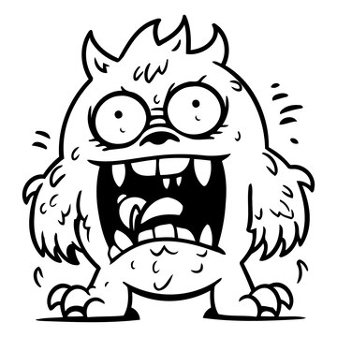

Slide 5
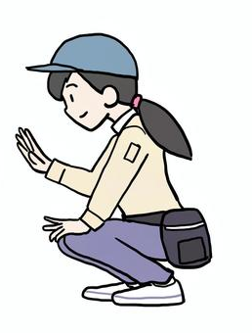

Learn to train and tame your monster.
Relax we’ve got this

Slide 6
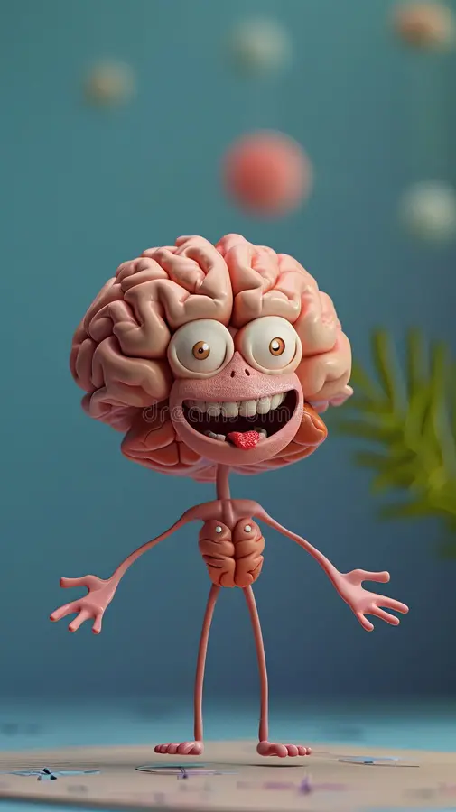
Slide 27
The Brain on Change – the fun sciencey bit!

Slide 7
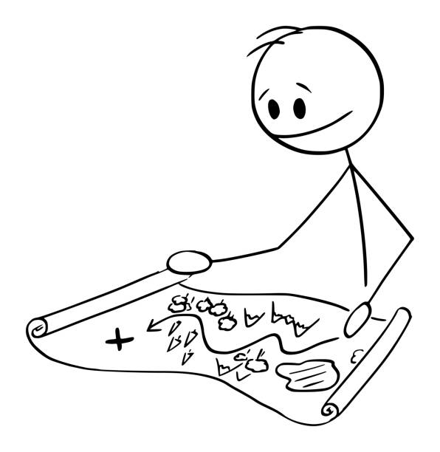

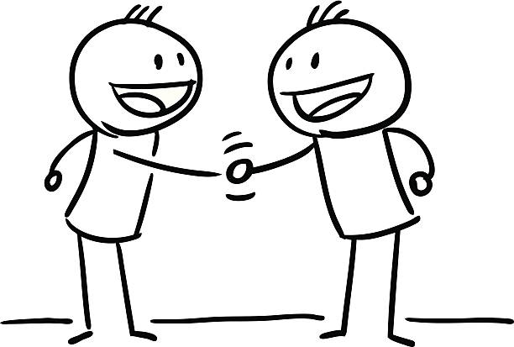
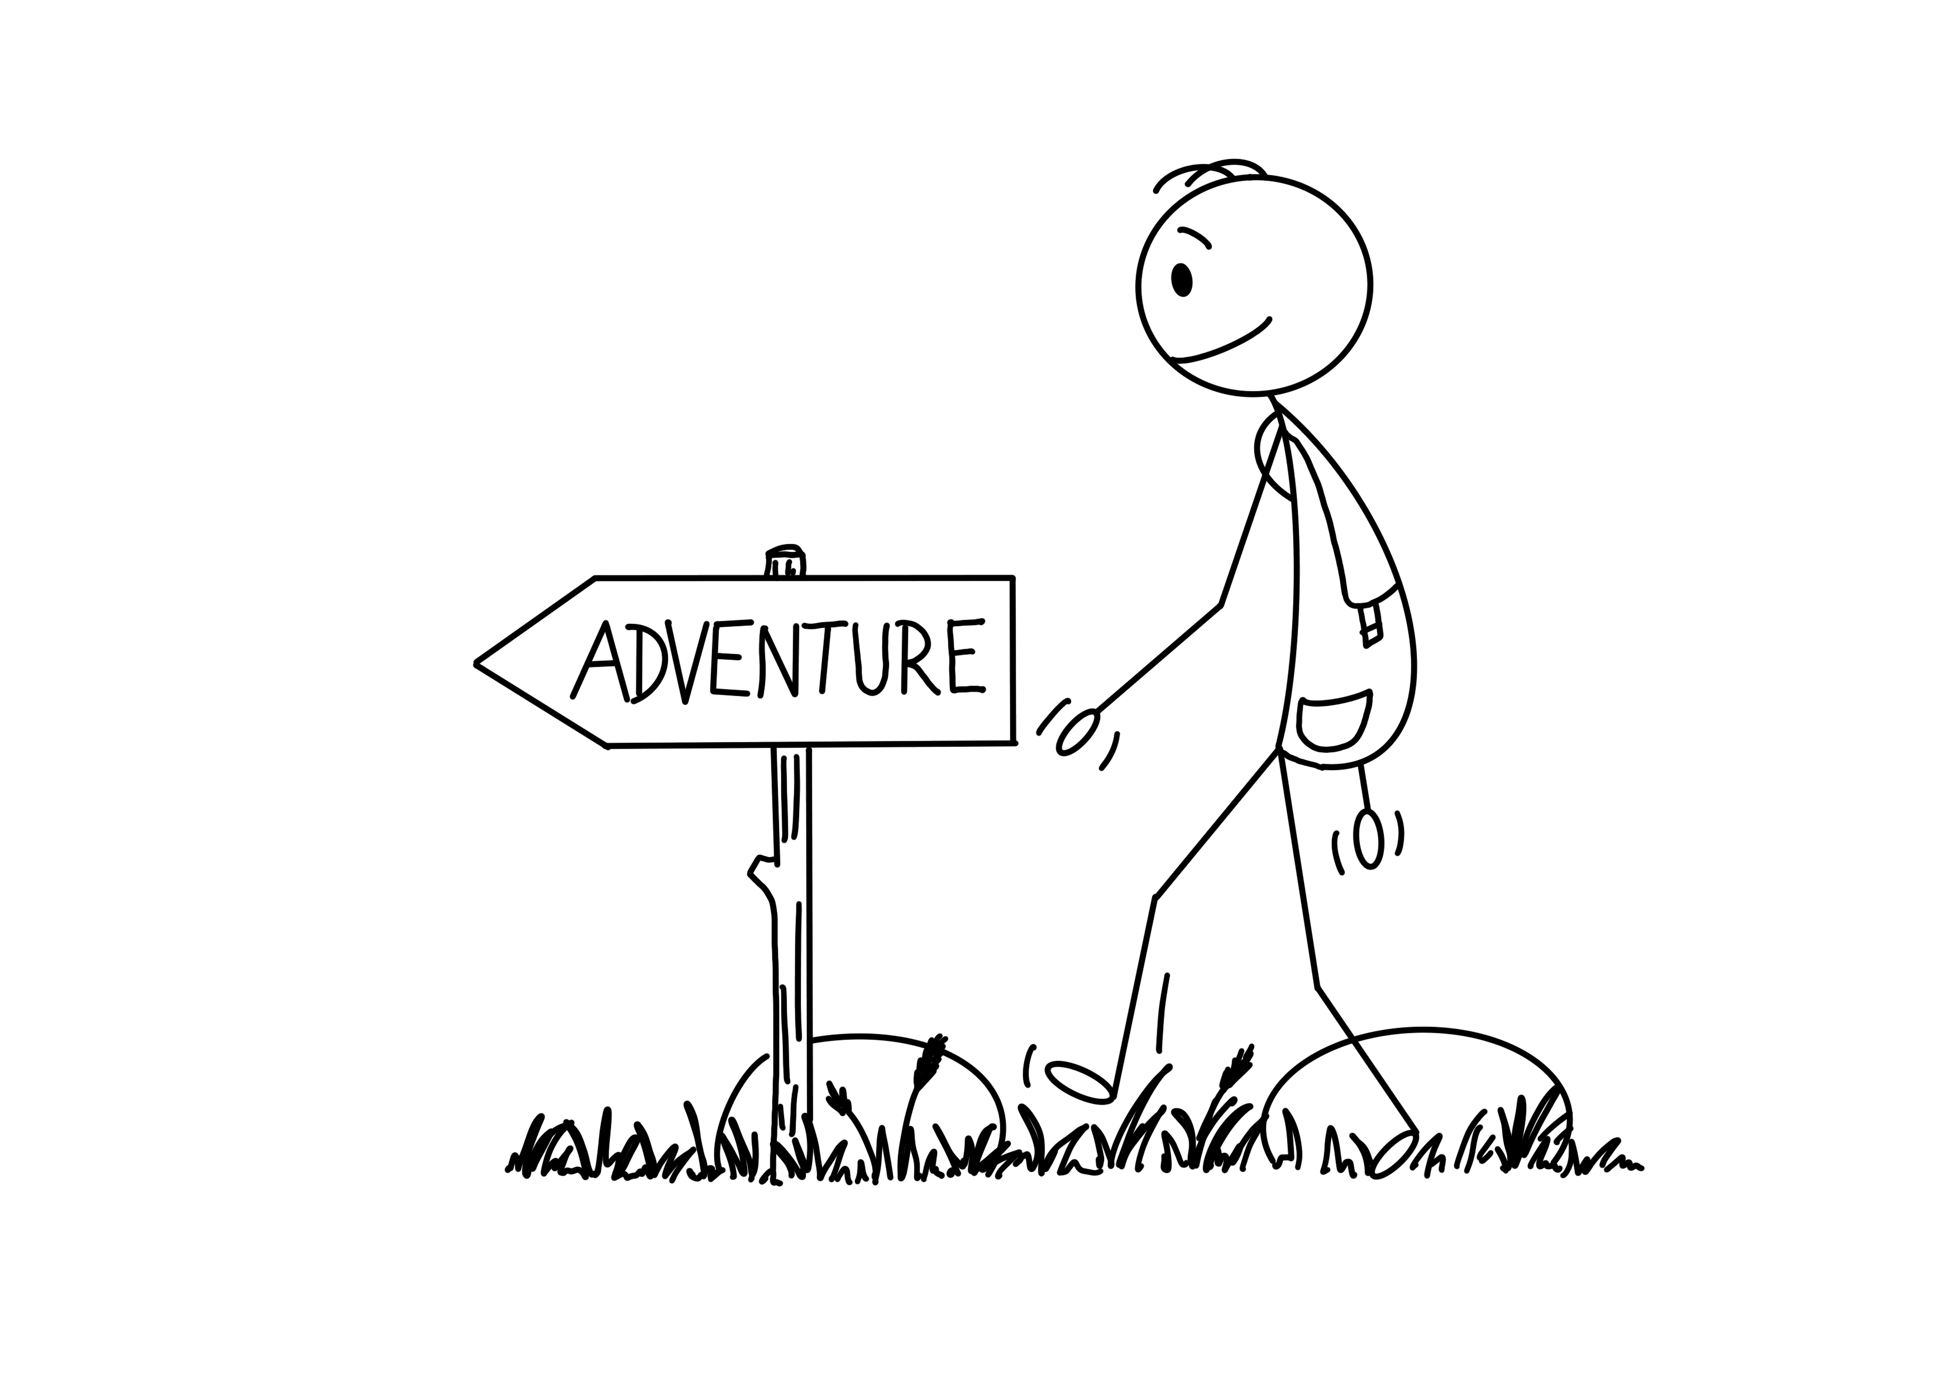
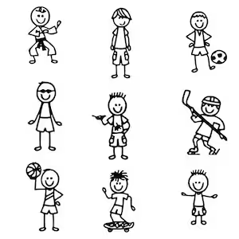
Don’t forget the Exciting Bits

Slide 8
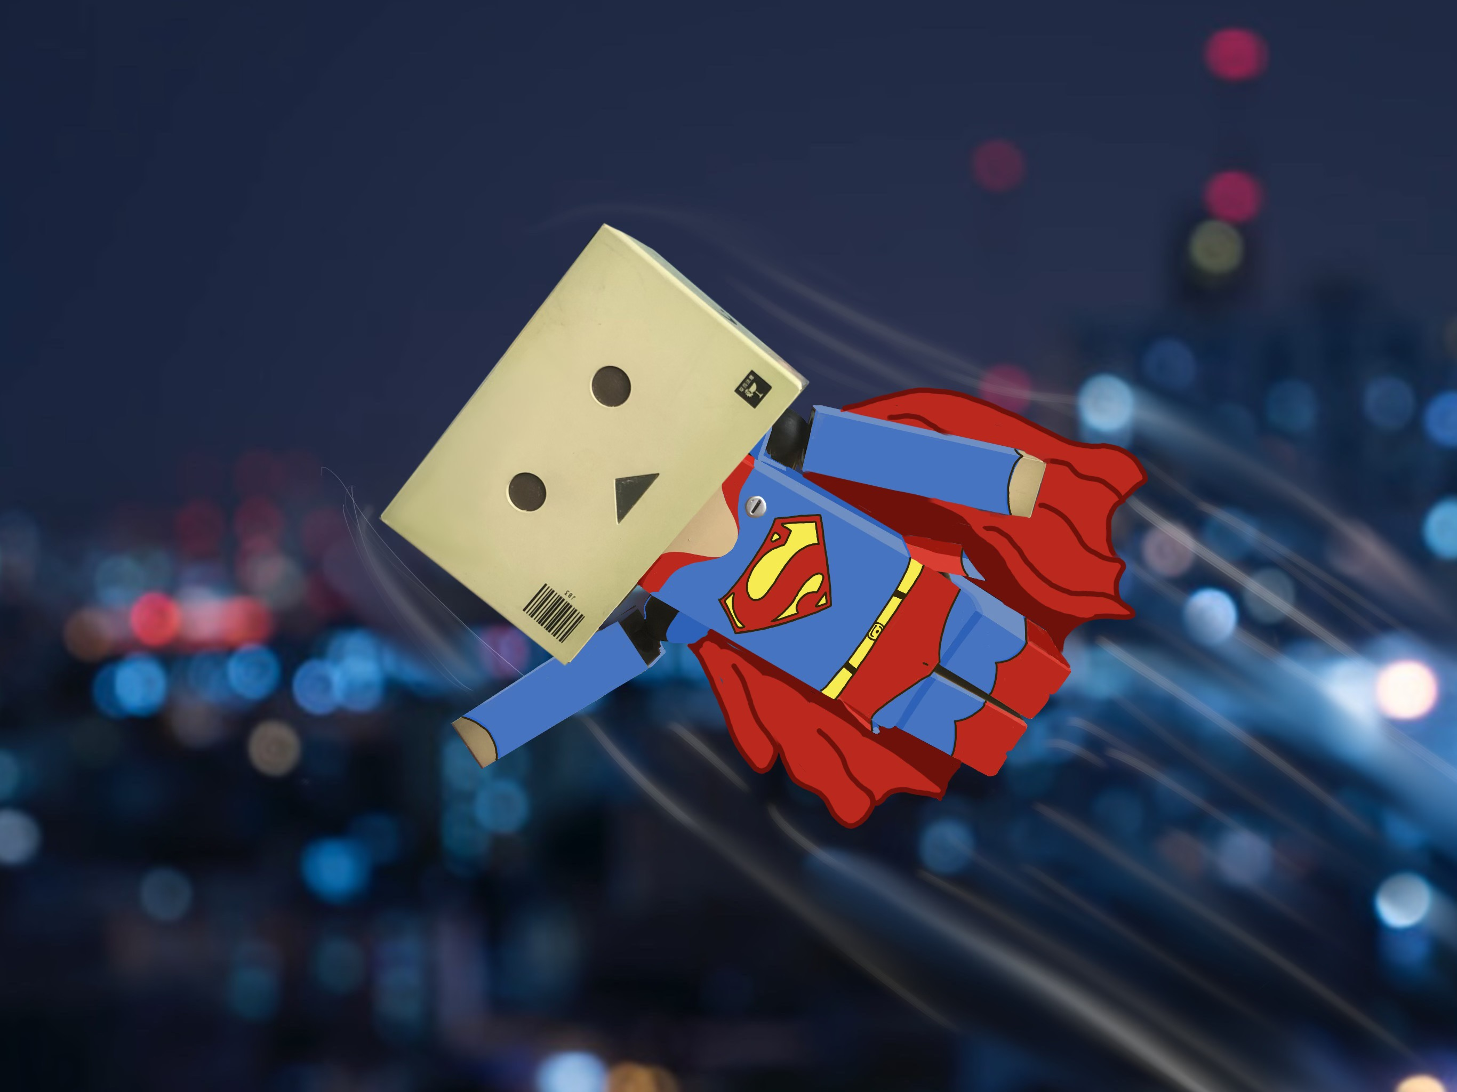
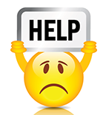

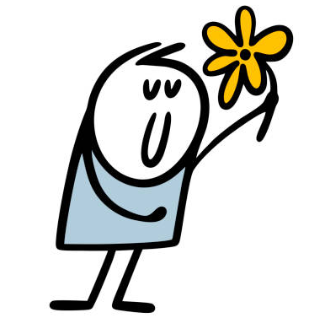
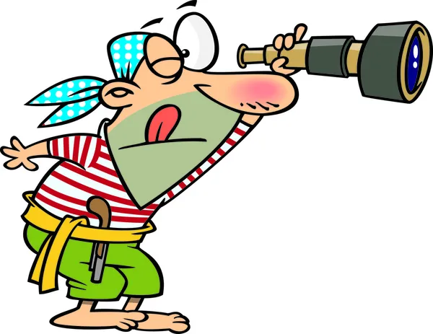
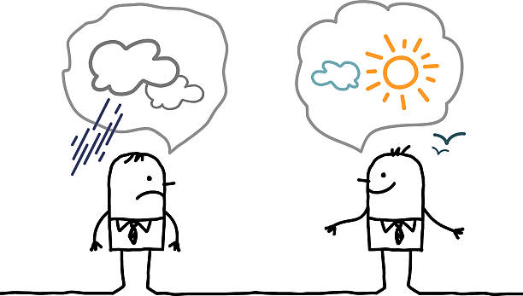
What tools do you carry in your toolbox already?

Slide 9
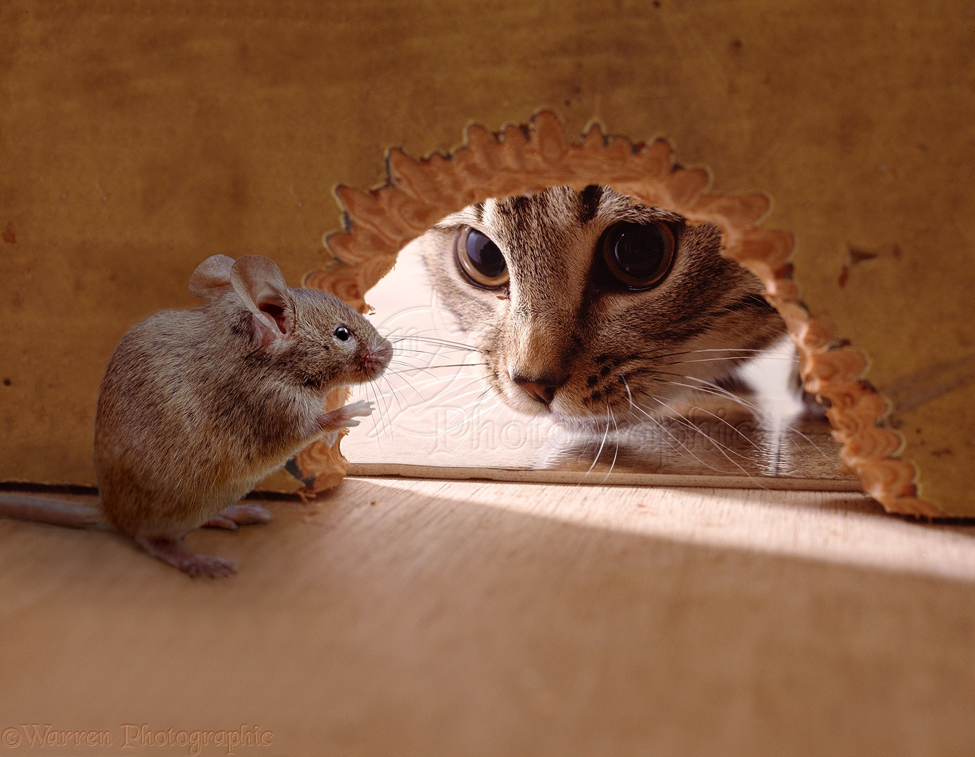
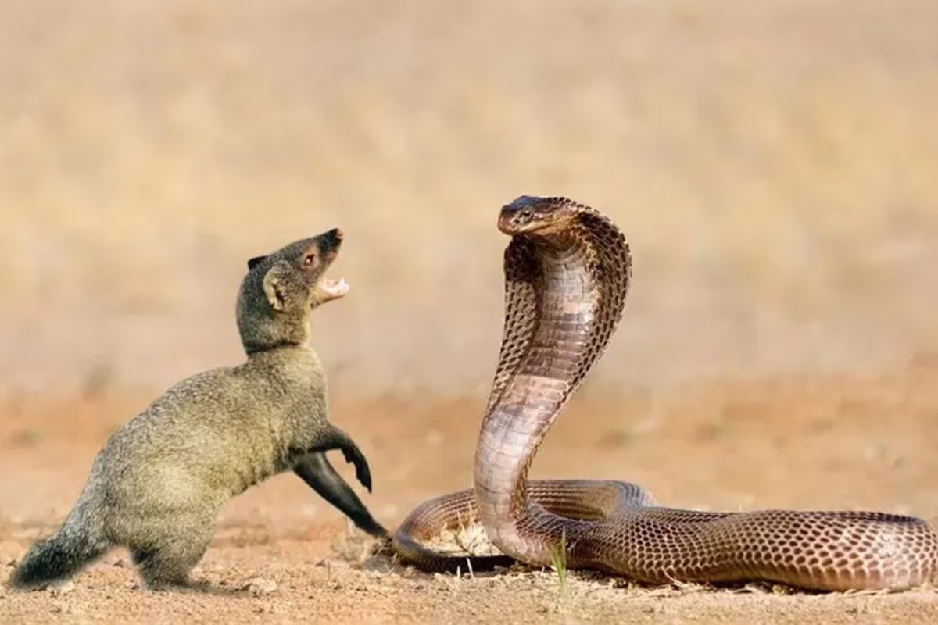
“You can’t be BRAVE unless you are a little scared” Brene Brown

Slide 10




Your Year 7 Mission: If you choose to accept it!
Ask at least one question when you are unsure
Do one kind thing for someone each day
Learn the name of 3 new people by the end of today.
Celebrate one thing that has gone well each day for the first week.

Slide 11




Remember ……….
U
Be BRAVE
Be KIND
Look out for others
BE YOU

